Slide 1
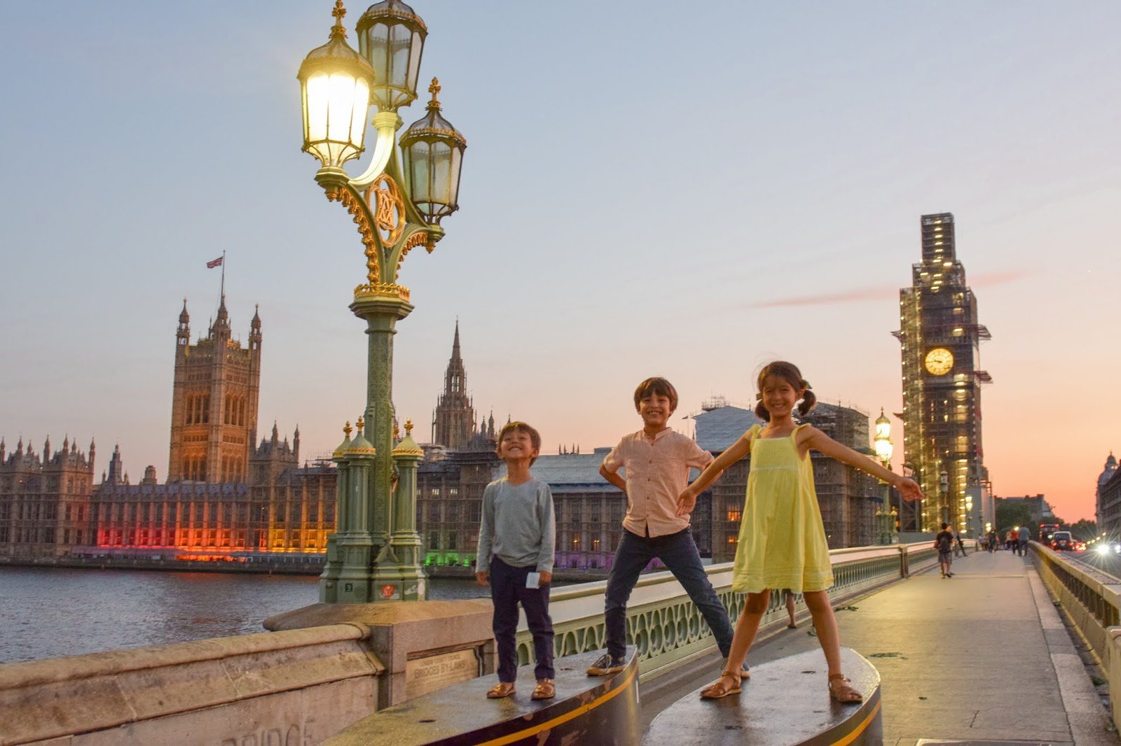
Welcome to our information session for the
Year 6 London Trip 2024

Slide 2
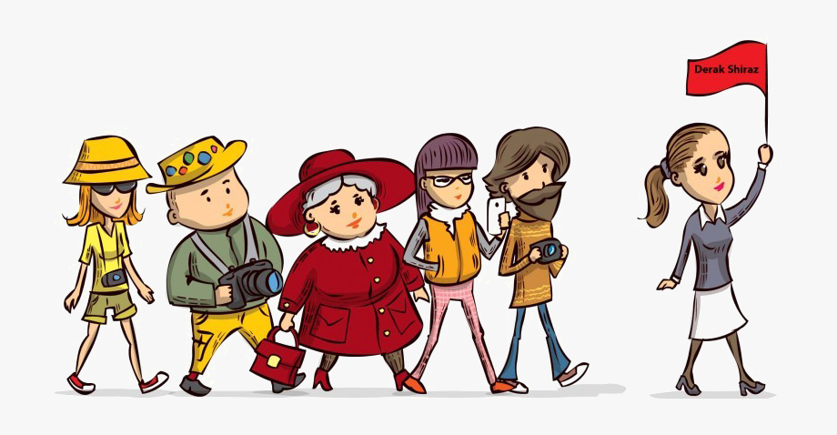
Party details
Trip leader: Mr Davids
Deputy leader: Miss Smith
Year 6 class teacher Miss Gorton
Mrs Pask – Middle School TA and First Aider
38 wonderful year 6’s

Slide 3
Dates of travel
Meet at SNMS on Monday 5th February, at *approx. 7am for a 8am departure.
Travel by coach to London
Children will need a packed lunch for the outward journey. Throughout the trip teachers will make packed lunches for the children.
Arrive in London at 12pm and at the YHA approx. 6 pm.
We will contact school informing them of our safe arrival & also post to social media.
Return to SNMS Wednesday 7th February at approx. 4pm

Slide 4
Itinerary
Mon 05 Feb 2024
08:00 Depart pick-up point
12:00 Arrive London
13:00 Visit Natural History Museum
18:00 Arrive accommodation YHA London Thameside 20 Salter Road London SE16 5PR Tel: 0207 232 2114 Fax: 0207 237 2919
18:30 Evening meal YHA London Thameside
Tue 06 Feb 2024
08:30 Breakfast
10:00 Visit Imperial War Museum IWM London tells the story of conflict from 1914 to the present day.
14:00 Sightseeing Drive around London to see Buckingham Palace.
15:45 Visit Boat trip - Thames See all the major sights on a trip between Westminster Tower - Sailing Time: 16:00
18:00 Evening meal YHA London Thameside
Wed 07 Feb 2024 08:30
Breakfast 09:00 Depart YHA London Thameside
10:00 Visit Houses of Parliament Please arrange this visit with your local MP.
13:00 Depart London
16:00 Arrive back at school

Slide 5
YHA Thameside
Virtual tour.

Slide 6
Breakfast
The YHA breakfast for groups consists of a continental buffet from which you may help yourself and a cooked full / vegetarian English breakfast served by the YHA team.
Lunch
Packed lunch – sandwiches (ham or cheese) made by the staff in the morning.
Please provide a water bottle for your child – we will bring some squash.

Slide 7
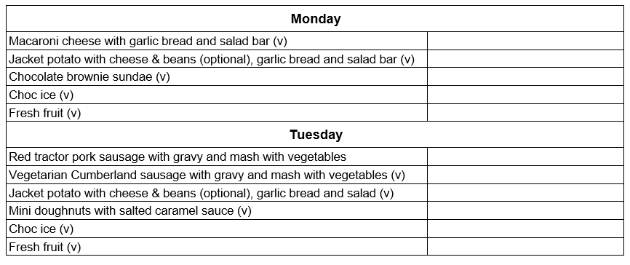
Evening Meal

Slide 8
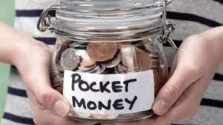
Pocket money!
At your discretion but we would recommend £30-£40 as we will be able to visit a couple of shops over the 3 days.

Slide 9
Medicine administration
Medicines prescribed by GP can be stored and administered by Mrs Pask
Name & details of administration should be clearly labelled on the medication when group gathers on the morning of departure and signed in to Mrs Pask.
Over the counter remedies e.g. medicines for migraines, antihistamines etc. can also be administered with clear guidance from parents/carers.
If appropriate, travel sickness tablets etc. should be taken prior to the outward journey and return journey. If your child is particularly sensitive they may want to have some for each day as we will be in the coach to get to various destinations and tours.
Children should carry their own asthma medication and, ideally, a spare inhaler should also be handed to staff

Slide 10
Kit List
All bedding is provided by the YHA so no need to pack your own but we do suggest a towel.
The key is to remember it is not a fashion show & comfort is important!
The weather is not guaranteed – February is usually cold so pack accordingly including coats, scarves gloves etc.
Digital Cameras (which will be collected by group leaders each evening)
Hand held gaming devices such as the old PSP or DS (without the camera) but NOT the Switch as this can connect to the internet.
NO MOBILE PHONES or devices which connect to the internet – This is imperative for safe-guarding reasons. Any mobile phones found will be confiscated so please do not allow your children to pack theirs!

Slide 11
Fire and contact
Deodorants - It is advised that children bring roll-on deodorants rather than aerosol deodorants as these can often set off fire alarms.
Contacting your child - Parents are asked not to call the centre except in an emergency. The centre telephones are business lines and may be needed for emergencies. (Mr Davids will be updating our SNMS facebook page daily so you will be able to see how we are getting on and what we have been doing each day.)

Slide 12
Any Questions?
?

